Slide 1

Dyslexia and Depression
Notes:
Children and adults with Specific Learning Difficulties battle an invisible condition easily misunderstood.
They’re quickly labelled as lazy, likes to avoid, lacking in ability or poorly motivated.
More than the incapacitating learning aspect IS THE EMOTIONAL CONSEQUENCE
Dyslexics often relate embarrassing, humiliating and soul-destroying experiences from school.
Self-image is vulnerable.
Sadness, anxiety, anger and depression are common.
There is now more than enough clinical research to show that both male and female dyslexics, compared to non-dyslexics, have a significantly higher profile of negative perceptions of their peers, of self-concept and of their academic futures. The result is a higher likelihood of emotional and behavioural turbulence due to inescapable feelings of stress or emotional discomfort.
For those of you who wish to read the clinical research, I have gathered 10 research articles for you.
The last slide will show you how to access them.
What do you, as GP’s, need to look out for more than anything when it comes to dyslexia and possible depression?
It’s paramount to consider the individual’s coping capacity, and the family’s coping capacity because they will have a lot to cope with no matter how well things may unfold.
Here’s Tim’s story, and how he chose to cope with his dyslexia … It’s a true story…
“You can't help me mum. I'm never going to learn to read.”
Our Timothy had been very flat for most of the summer holidays, but the last couple of weeks were particularly hard for him. He had cried a lot about having to go back to school. A day did not pass without him questioning why he had to go. With a week of holidays left the tantruming subsided, but the tears continued. It seemed he had resigned himself to return to school.
His younger brother and sister were asleep, Timmy was watching the television and I was in the kitchen.
‘Thud.’ A couple of seconds passed. ‘Thud.' A few more seconds passed. ‘Thud’ is the only way to explain the sound. It was deep and powerful like nothing I’d heard before and recalling it makes my heart jump to my throat.
'Thud.’ It got the better of me, so as good mothers do, I went to investigate. Not often did I need to check on Timmy, we had been blessed with a calm, thoughtful child. I made my way into the lounge, stepped inside and looked. There I saw Timmy doing a tall hand stand on the couch.
"Timothy how many times have I told you and your brother?”
'Thud.’
"No. No. No. No. Stop!"
It all hit home. He was lifting himself up as high as he could with his hands on the back of the couch, and then jerked his hands away so his head crunched into the couch seat below. The 'thud' was his feet hitting against the wall helping to propel him with all the more force into the seat.
I grabbed him and pulled him onto my lap.
“You could break your bloody neck if you keep doing this!” I screamed.
“I know,” he calmly responded.
“If you know why on earth are you doing it?”
“I don't want to be here.”
Innocently, I said, “That’s fine. If you’re bored don’t stay here. Go and do something else.”
“No. I don't want to be here. I want to die," he said staring up into my eyes.
He continued, “I don't want to feel this way anymore and if I am dead I won’t have to go to school.”
“You can't help me mum. I'm never going to learn to read”.
I hugged him and sobbed. I couldn't let him go.
Timothy had spent eighteen months in preschool, eighteen months in reception and twelve months in year 1. After four years of formal education he had stalled on the readers from the orange box. Each of them had just a word or two to a page. His best friends were beginning to read the Harry Potter books. A few months later Timothy was identified with a learning difficulty, dyslexia. That helped to explain why he has such confusions, but it hasn’t changed the way he feels about it.
I love our son. I hate our lounge. I still can't think of our beautiful desperate little boy bouncing on his neck because he didn't think there was anything else he could do. Timothy was seven and half when he tried to escape the world because he couldn't read.
Suzie, Timothy’s mother
Tim is now 15, and is a beautiful young man.
He’s lucky because he’s found dancing and he’s brilliant at it.
He perseveres at school and copes really well, keeping his LD in perspective.

Slide 2

‘A specific learning difficulty’ (SLD) -
when individuals (15%) do well in some areas of
learning, but unexpectedly have problems in others
‘Dyslexia’ or ‘Reading Disorder’ (10%) is a common type
of SLD, but students may also have problems with number skills - ‘dyscalculia’ and writing capacity - ‘dysgraphia’
Notes:
Slide 2
Let’s jump into Specific Learning Disability
(SLD) is a broad umbrella term.
It attempts to explain why a person is able to do relatively well (even really well because you can be gifted) in some areas of learning, but encounters unexpected problems in other areas.
Typically there are 3 areas where problems occur;
Difficulty with number skills - dyscalculia
problems with writing output - dysgraphia
and reading difficulty - dyslexia
Best estimates tell us that about 20% of the population are affected by some form of language-based learning difficulty.
SLD’s probably account for about 15%
Dyslexia affects a little over 10% of the population (BDA, 2012), so that's about three kids in every class room.
It is inherited.
It is not a mental illness, a sickness or a disease.
6 genes have now been linked to the disability – one being "KIAA0319“
It effects the way an individual processes language and is on a sliding scale of severity.
Dyslexic individuals may also have problems with time management, personal organisation, and co-ordination and orientation. In combination, their listening comprehension may be affected, especially when under pressure.
Interestingly, SLD’s have really only 'existed' since we’ve have had to learn to read, write and do maths.
They became especially pronounced when some bright spark introduced the dictionary, and called for standardised spelling. We’ve got a scapegoat – apparently we can blame Samuel Johnson who created the first dictionary in 1755. It had about 10,000 words!

Slide 3
4 Subcomponents of Dyslexia
Core
problems
Phonological
awareness
Rapid
automatized
Naming
(RAN)
‘Verbal short
term’ and
‘Working
memory’
Span
Visual-
orthographic
processing
Notes:
Slide 3
There’s ongoing debate about what exactly constitutes dyslexia.
So, let’s look at what the experts do agree on – the image on the screen summarizes ‘the dyslexic impairments’.
Phonological awareness difficulties are always apparent - this is the ability to break words down into sounds, actually hear the sounds and the syllables, be able to discriminate these sounds from one another, and to manipulate them.
RAN refers to how quickly individuals can recall or name aloud objects, pictures, colours, or symbols (letters or digits). Variations in RAN time in young kids provides a strong predictor about their later ability to read.
Then, there’s the capacity to break the alphabetic code – that’s the orthographic processing - recalling the letter – naming the letter – recalling the sound links and naming them.
Hey, this is no easy task, because English is such an irregular language - 44 sounds represented by 26 letters! That’s hard!
In essence, the term dyslexia refers to a spectrum of problems:
some can read but not write,
others can write but not read,
most are somewhere between these extremes,
although some can neither read nor write.

Slide 4

So, how does this look in real life?
Notes:
Slide 4
So, how does this play out in real life?
Early on kids have difficulties pronouncing longer words, and finding the right word. At first it seems cute!
Early on, good teachers notice difficulties in their ability to acquire basic reading, writing and spelling skills. The link between sounds and letters does not develop as it does for others. Their reading lacks fluency and speed.
They trip over small common words. They read words that are not there, keep forgetting the same simple words and lose their place. They sound out syllables as they read, but forget them before they are able to blend the entire word together – it is so frustrating for them.
Later on, these are the kids who can learn for their spelling test and get ‘good’ marks. Then, when tested on the same words three weeks later they achieve poorly.
A common observation is that they spell words their way - very phonetically.
Also watch for poorly developing written language. Dysgraphia is a writing impairment. Kids with dysgraphia are often slow to learn to write; may experience letter reversals, produce inappropriately sized letters, mix upper and lower case letters, forget word spaces and produce untidy and inaccurate bookwork. These students just cannot seem to formulate their thoughts on paper, and their teachers often comment on the limited production of written work.
Mathematical difficulties may be present as well.
Indicators of dyscalculia include constant number reversals (eg. 37 becoming 73), copying inaccuracies and continual misreading of written information so that mathematical outcomes are skewed. These students battle can't remember maths symbols, often saying, “that’s an adding sign, isn’t it?”
They have great difficulty learning and retaining simple formulas, remembering the sequential steps involved in basic maths operations and recalling number patterns (especially the multiplication tables – many will never be able to learn them all).

Slide 5
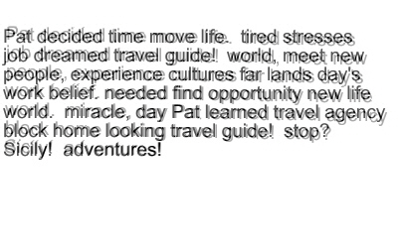
Read the following passage
‘Feel’ what happens to your comprehension as you read it
I’ve added a little disorientation to help you ‘feel’ the confusion
Notes:
Slide 5
Read the following passage
‘Feel’ what happens to your comprehension as you read it
I’ve added a little disorientation to help you ‘feel’ the confusion.
Here’s one way to understand dyslexia – to get an ‘idea of how it feels’.
How did you feel?
What thoughts does the exercise leave you with?

Slide 6
“Copy this from the board!”
Your task – copy this and substitute each vowel with a @
Start now. Be quick! Go, go, go! Hurry up! Haven’t got all day!
Dyslexia is a neurologically-based condition which is inherited.
It causes problems with reading, writing, spelling and is usually linked to difficulties with concentration, short term memory and organisation.
Dyslexia is not the result of stupidity, nor is it a gift. It is not caused by poor schooling, poor home background, poor motivation for learning, poor sight, poor hearing or muscle control - although it may occur with these conditions.
Notes:
Slide 6
What is dyslexia?
Let’s continue to inhabit a dyslexic student's world for a few moments
Use this dyslexic exercise with conference participants:
So, I want you to copy from the screen.
I want you to substitute each vowel with a ‘@’.
I want you to start now!
Hurry up… push them along... hurry them along….
What feelings did you experience as you forced yourself to do this exercise?

Slide 7
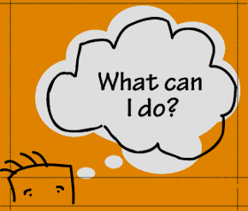

Take home tips for "Monday morning in the clinic"
Is it dyslexia? Dyslexia checklists available from;
http://www.dyslexiavictoriaonline.com/chofdyin.html
http://www.dyslexiaaction.org.uk/dyslexia-check-list
http://www.bdadyslexia.org.uk/about-dyslexia/adults-and-business/i-think-i-might-be-dyslexic.html
http://www.dyslexiaa2z.com/learning_difficulties/dyslexia/dyslexia_childrens_checklist.html
Your SPELD organisation http://www.speld.org.au/
Notes:
What can I do?
If you think a child or an adult may have dyslexia, get hold of a dyslexia checklist and help them fill it out. This is a great start.
If the results convince you that ‘dyslexia’ or some kind of ‘language/learning-based issue’ is probably at play then it’s time to refer them to a skilled psychologist. Just as your profession specialises, so do psychologists – not ALL psychologists are adept at identifying dyslexia, especially in young children. Some psychologists do better jobs than others making the report personalised and filled with practical strategies and sensible interventions to help students, teachers and parents.
Skilled psychologists can find strong dyslexic indicators or markers in children as young as 4 years. Results certainly become more accurate, more concrete as kids approach 7 or 8 years of age.
What about if you don’t know a skilled psychologist in this area who is also fabulous with kids?
Then ask around, or speak to your local SPELD association. They’ll offer the best contacts.

Slide 8
Take home tips for "Monday morning in the clinic"
Dyslexia and depression?
Got to consider their coping capacity, and the quality of the support network they have around them
Co-Morbid Diagnoses with Dyslexia
Most Common
Dyscalculia
Dysgraphia
ADD and ADHD
Learning Disabilities
Autism Spectrum Disorders
Others could be . . . .
Conduct Disorders
ODD
OCD
Tourette's Syndrome
Sensory Integration Dysfunction
Sensory Impairments
Notes:
Dyslexia and depression
Depressed or not, the road ahead for a dyslexic child is tough – even with the right kind of teachers and parents.
To find success they will have to work so much harder, put up with many frustrations and deal with constant misperceptions by others.
They face a long tricky road that requires big doses of resilience because there will be big ups and downs.
Based on this, you have to consider their coping capacity, and the quality of the support network they have around them.
Are they a ‘glass half empty’ or ‘glass half full’ kind of person?
Or, are they more prone to positive or negative self-talk?
Are they more likely to blame others, or live in denial?
Are they a positive problem solver who shows determination?
Are their parents positive problem solvers by nature?
Does depression or anxiety also run in the family?
Does the child know what dyslexia is?
Do their parents really understand it?
CLICK
Might a SPELD short course increase their understanding?
Do you need to refer them to a psychologist who can counsel the parents and/or the child – even if it’s to set them on the right road and set them up with the right kinds of resources, understandings and contacts?
Will you need to keep a close eye on their emotional journey?
And, this is the time to mention that dyslexia is a comorbid condition.
There seems to be a high co-morbidity with dyslexia and ADHD – about 65% of those with ADD have dyslexia as well.
We need to be mindful of these relationships

Slide 9

Take home tips for "Monday morning in the clinic"
‘Dyslexia Friendly Schools’
Can you lend support?
If you can contact your local SPELD
What does a dyslexia friendly school’ look like?
Find out by reading this article
http://www.theage.com.au/national/education/seeking-a-new-deal-on-dyslexia-20100528-wl5z.html#ixzz28pg7CF9b
Notes:
Slide 9
Get involved, even if it’s just in a minor way, with the ‘Dyslexia Friendly Schools’ program.
It’s currently being promoted in Australia by the UK’s Neil MacKay, and supported by a range of parent and SPELD groups throughout Australia.
It’s a push to achieve equity for our dyslexic kids.
Many ‘Dyslexia Friendly Schools’ already exist in the USA, Ireland and the UK.
Yes, we’re being left behind!
Much of the discussion about dyslexia in schools in Australia is from the dark ages.
Some of it still relates to whether the condition really exists. And, apart from New South Wales, it is not legally recognised as a legitimate learning disability in most school systems
What does a dyslexia friendly school look like? Pretty unremarkable really…
there’s NO stigma about having a learning difficulty – dyslexics simply learn differently
the hurdles they face are acknowledged and ways are found to help them learn cope
there’s easy access to text-to-speech and predictive typing software
teachers receive specialised training
There's an awareness that there are some people who need other ways of expressing information and getting information.
Excerpt of a letter written by one of my year 11 students to his history teacher
“You don’t get it and I need you to. If all you want me to do is write essays all the time then all you are testing is my learning disability, and I’ll just keep showing you I’ve got a really big one!”
Actually, ‘dyslexia friendly schools’ works for everyone, not just the kids with dyslexia – in truth the approach has a name, it’s called – “good teaching”
Thankfully, there are some good schools about with willing and skilled teachers who understand dyslexia and are committed to making a difference.
But, you’ll need to hunt them down!

Slide 10
Take home tips for "Monday morning in the clinic"
Offer reassurance
demonstrate untiring faith to help dyslexics find solutions
investigate dyslexic individuals who have lived good lives and made great contributions. You’ll be stunned!
Orlando Bloom, Charley Boorman, Keanu Reeves, Kiera Knightley, Billy Bob Thornton, Alexander Graham Bell, Cher, John Lennon, Richard Branson, Henry Ford, Walt Disney, Tommy Hilfiger, Pablo Picasso, Jackie Stewart, Agatha Christie, Paul MacCready, Winston Churchill, Napoleon Bonaparte, Charles “Pete” Conrad Jr., Robbie Williams, Billy Connolly, Charles Darwin, Galileo Galilei, Orville and Wilbur Wright, Albert Einstein, Jessica Watson, Kerry Packer, Ernest Hemingway, F W Woolworth, Lugwig Van Beethoven, Harrison Ford
Notes:
Slide 10
Reassure them that they’re not the first person in the world to have dyslexia.
Reassure them that many well known dyslexics have done really well with their lives.
And, don’t only rely on ‘famous others’.
Sometimes there are people who’ve done okay for themselves much closer to home – yourself, their mother, father, auntie, uncle, cousin or grandparent. Good homegrown models can be inspirational blue prints.

Slide 11
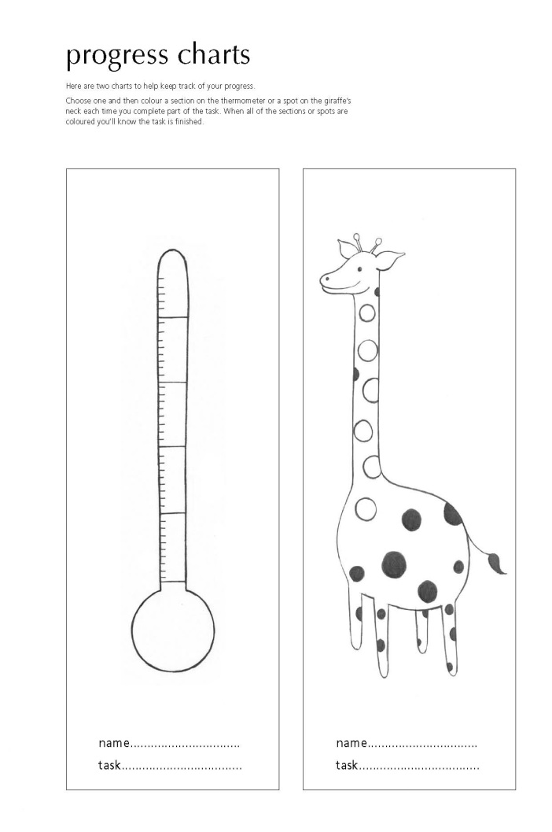
Take home tips for "Monday morning in the clinic"
Educate all to understand;
  dyslexia is life-long. It won’t go away
  use schedules, charts, lists, calculators, formula sheets, weekly planners, word processors, sticky notes, etc. to aid memory
CHUNK tasks to measure progress
listening memory is impaired. Reduce verbal memory load, so
increase visual cues
Notes:
Slide 11
Teach kids how to take advantage of the organising systems – any organising system that works for them!.
These include calculators, phones and hand-held organisers. Some of my secondary students use their mobile phones to take photos of the homework written on the board at the end of lessons.
Teach all how to make ‘stickies’ that come up on the screen as the computer boots up.
Similarly, Microsoft Office Outlook can be used as a wonderful little memory jogger having the capacity to set up lists, schedules, time lines for assignments and reminders.

Slide 12
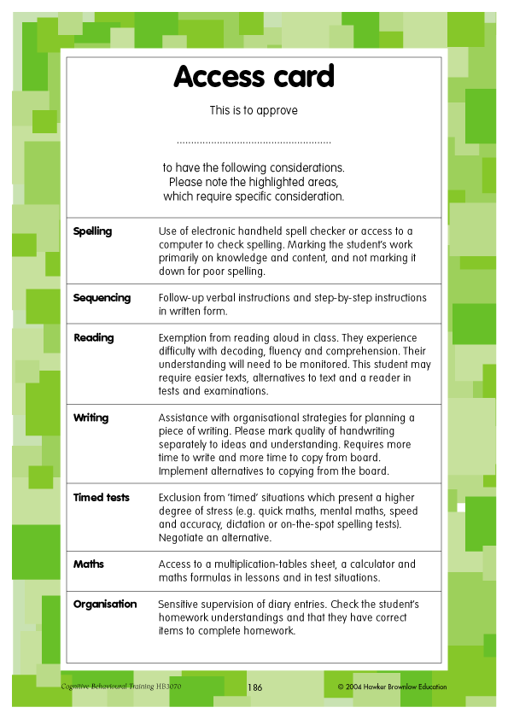
Take home tips for "Monday morning in the clinic"
Differentiate Curriculum - ‘access cards’
“An ‘access card’ can be fastened into the back of the student’s diary with the special provisions highlighted.”
Notes:
Slide 12
With the introduction of the ‘Disability Standards for Education’ developed around the Disability Discrimination Act of1992, there is an onus on every school, college, university and teacher to manage students with all kinds of differences far more vigorously.
A popular idea for students to have an access card. The card, displaying the special provisions, can be fastened into the back of their diary so it is easy for all teachers to see.
For students identified specific learning difficulties the ‘access card’ is likely to state things like;
exemption from reading aloud in class
student to receive handouts instead of coping notes from the board
supervision of diary entries for homework
Or that the student has a modified homework program
extra time in tests and exams
use of computer in lessons and tests
use of calculator in lessons and tests
use of hand held spell checker in lessons and tests
assistance with organisational strategies when planning an assignment
work to be marked without penalty in relation to spelling and grammar
provision of a reader or a scribe in tests

Slide 13
Take home tips for "Monday morning in the clinic"
And, it may not be all about reading;
Writing - can be slow, laboured, reduced and messy
Spelling - probably won’t pick up. Spellcheck is limited.
Copying from board - slow and inaccurate
Good teachers provide photocopied notes and a highlighter so students can highlight what’s relevant
Time - they work slower, so a focus on key objectives with a reduced amount of work is best
Notes:
Slide 13
Let me tell you about Jake.
Just like his father, Rick, he was dyslexic big time!
And, just like his dad he had a desire to succeed, and the ‘grit’ to do it.
At 9 years of age Jake tried to burn the primary school library down. He thought that if he could get rid of the books – and all the print they contained – then, his world would improve no end!
I also remember when I showed him how to ‘cut and paste’ from the net. He was 11 at the time, and he cried with relief that never again would he have to start with a blank page or screen. It was so liberating! And, of course, we had conversations around plagiarism, and loads of lessons on how to convert the text of others into his own words.
But, of greatest interest to you was an event that occurred during Jake’s weekly session with me.
At the time he was 17 years old and in year 11.
We’d spent most of the session planning an assignment, and had just started on the introduction together. I needed a coffee so left the room for a 5 minutes leaving Jake to continue.
When I returned I noticed a list of a dozen words or so on the screen. They shouldn't been there.
I asked Jake about the list.
His response; “Mark, I kept writing and then I got to the word ‘really’. I had no idea how to spell it. So, I decided to write down as many ways to spell as I could for you. You know what, Mark? They all look right to me.”

Slide 14
Treatment of dyslexia
Specialist intervention required
Start young
Dyslexics learn in a different way - need phonological training
Doing more ‘schoolwork’ won’t work
Research supports the ‘Orton-Gillingham Multisensory Method’ http://www.ortonacademy.org/approach.php
Don’t forget to have eyes checked by a behavioural optometrist
Take home tips for "Monday morning in the clinic"
Notes:
Slide 14
Treatment of Dyslexia
Dyslexia can be remediated (not cured) with proper therapy and training.
Specialist intervention at a young age is always recommended.
But, it is a long process and takes true commitment by kids and parents.
It can also be costly.
Dyslexics learn in a different way, so any support must be dyslexia specific.
Putting dyslexic pupils in a remedial group for struggling learners, getting them to do more of the same or repeating a year just doesn’t cut it.
Interventions must focus on phonological awareness training (often involving breaking words into their basic sounds and rearranging these sounds to produce different words). This can improve reading skills – we often see young children beginning with a speech pathologist starting early with this.
The Orton-Gillingham Multisensory Method - developed in the early 1930's - has special way of teaching phonemics and language structure to dyslexics. Research evidence supports it’s approach, and it is used in some schools.
A number of programs, such as Hickey, has been developed around this approach.
The approach is multi-sensory so it involves all of the student’s senses: visual, auditory, tactile, and kinesthetic.
Oh, before beginning any treatment have the visual components checked by a behavioural optometrist who understands dyslexia.

Slide 15
Take home tips for "Monday morning in the clinic"
Assistive technology
Go to services/SPELD SA blog http://speldsa.wordpress.com/
Free Natural Reader Version 11
Talks text from anywhere out loud to listen to - simple and free
Free 7 Sticky Notes
Great way to help everyone plan, stay on task, finish and remember
Speak Selection tool on iPhones, iPads and iPods
It can read out loud any text sent to you or gathered from web pages
‘Dragon SpeakingNaturally’ Premium Edition
Voice recognition remains tricky to train, but can be brilliant! ($127)
Audacity
Free recorder – great to record ideas into or to record assignments
Notes:
Slide 15
Never think that assistive technology should be delayed until dyslexic students learn the basic skills of handwriting, spelling, grammar or reading first.
Hey, these kids learn differently, and no matter how well they are taught many will never cope with these rudimentary skills.
They need legitimate options to take short cuts to reduce the frustrations of intermittent memory weaknesses for spelling rules, grammatical conventions and basic number facts.
Why make a student agonise over their memory difficulty when they could use an inexpensive device to take the pressure off?
Not only does this practical approach allow kids to access their higher level thinking skills more easily, but helps to buoy their motivation as successful learners.
This is a ‘dyslexic friendly’ approach!

Slide 16

Take home tips for "Monday morning in the clinic"
Social skills
Learning difficulty does not always confine itself to academics
It can impact on how an individual perceives the world, listens,
remembers, copes and interacts with peers
Notes:
Slide 16
Social skills
Feeling humiliated or sensitive about learning most lessons doesn’t set the perfect footing for reciprocal friendships.
It’s hard to cement friendships with someone who’s a bit too enthusiastic, is moody, who has a ‘chip on their shoulder’, who is too sensitive, who thought jumps, who forgets and seems a bit stuck in their world.
And, the research is crystal clear - without adequate social success children and adolescents are far more likely to be at risk from emotional and mental health difficulties!
The impact of attaching to peers is significant.

Slide 17
Take home tips for "Monday morning in the clinic"
Good ‘social skill’ programs
Bounce Back, www.bounceback.com.au
Cool Kids Program, http://www.emotionalhealthclinic.com.au
Coolness Under Pressure, http://mhws.agca.com.au
Friendly Kids, Friendly Classrooms, www.bounceback.com.au
Play Is The Way, www.thegamefactory.com.au
Resourceful Adolescent Program (RAP), www.rap.qut.edu.au
What’s the Buzz? www.whatsthebuzz.net.au
Notes:
Slide 17
Social skills
Sometimes an edge can be found by immersing kids in a formal social-skills training program - with peers - where they’re explicitly taught how to behave in pro-social ways benefits.
They also engineer opportunities for kids to feel the embracing comfort of warm interactions with peers.
There are some quality social skills programs about, and they can be easily tracked down.
And, never forget to mention to parents the value of clubs, associations and social groups that exist in the local community. What a way to connect socially over an interest. What a fabulous way for a young person – a person of any age – to find vale in themselves and in others!
Gather up your contacts and distribute them to support young people and families make healthy connections.

Slide 18

Take home tips for "Monday morning in the clinic"
Help them ‘love’ their disability
Well, at least work to normalise it!
Notes:
Slide 18
I remember asking 13 year old Brett how he felt about his dyslexia.
He reached for a black jumbo sized texta and a blank sheet of paper on my desk.
Next, he placed eight bold black dots randomly over the page, and explained that each one represented something in his life.
As he circled one dot he spoke about his downhill racing and how he loved it.
Another dot indicated the value he placed on his friendships.
The next showed his enjoyment of collecting movies.
Next was his connection to his family, and he continued until he reached the last dot.
As he circled it, he explained this one was his learning difficulty. But, it was just one part of his life.
Brett had it in perspective! Yeah, great coping skills!

Slide 19

Thank you
This PowerPoint, the notes from the presentation, references, additional articles and ‘Chapter 4: Strategies to help organisation and memory; inside Tough Kids with learning disability’ from my book TEACHING TOUGH KIDS, are available to you as a gift from my website.
Go to; http://marklemessurier.com.au/main/workshops/teacher/
See Presentation 12
Notes:
I’d like to wrap up with Penne;
“Late last year on my 16th birthday I found out I was dyslexic.
I’d never heard of it before, but it answered lots of questions for me.
Having dyslexia was like carrying a heavy weight on my chest, and it hurt. It made me feel so stupid every day in front of everyone I was growing up with.
It caused my low grades and it meant that teachers had to put up with me spitting it, giving up on work, and saying how life’s not worth it.
And, my friends they’ve had to put up with me being happy one minute and upset the next.
My family, well, they had to put up with all this, and me cutting myself. Every Sunday afternoon I used to feel so depressed about having to do homework or going back to school. By the evening I’d be making new cuts or going over old ones.
What’s the worst thing a teacher ever said to me?
My maths teacher told me in front of the class that I was useless, and would never amount to anything. That was last year. After she said that I found school even harder.
I can’t believe she made me blame myself for something that isn’t my fault. To calm my anger at her I’d sing a song I liked over and over in my head.
Then she left the school. Now I can’t listen to that song without crying.
But to this teacher I say, “I’ll succeed in life. I’m much more than the speck of dust you saw me as.”
How can people help? The most important thing is for them to be positive.
To praise dyslexic kids so we know we are going in the right direction and can make it.
But the most brilliant thing is the support I’ve got from teachers this year now they know I’m dyslexic.
I feel so relieved that I don’t have to go through this by myself anymore.”
Pennie, 18 years

